Slide 1
Problem Statement Worksheet (Hypothesis Formation)
What is the business problem you are investigating?
The company have an insufficient pricing strategy, after a cost of $1,540,000 the company is looking to have a data-driven pricing by evaluating their facilities and amenities and that will either justify a higher ticket price or cutting costs by finding what facilities or amenities cost and how much value they are to the customers
1
Context
4
Constraints within solution space
<Why are you working on this problem?>
The business has an insufficient pricing strategy to offset a $1,540,000 operational cost increase per season, we will create a market analysis of 330 different competitors to identify the value of the business amenities and facilities to help the business make a more data driven pricing strategy of either supporting a higher ticket price or cutting costs on certain amenities or facilities before the start of the upcoming season
<What constraints exist that may prevent this business initiative from succeeding?>
Data quality and restrictions
If the company is a pony and one of a kind and does not really compare much to its competitors then the model may under-predict its true value.
2
Criteria for success
5
Stakeholders to provide key insight
<What is the key criteria that will deem this work successful?>
Recommending a ticket price based on the market research of 330 different competitors and identifying the value of each amenities and facilities and their contribution to the ticket price before the start of the next skiing season
<Who are the key stakeholders that need to be involved in this project? Where will you source your data from and who will you present your recommendation to once you have identified a solution?>
Jimmy Blackburn, Director of Operations,
Alesha Eisen, Database Manager.
3
Scope of solution space
6
Key data sources
<What is the focus of this business initiative? I.e. What are the specific items you will you focus on exclusively?>
Conducting a market research with 330 different competitor data to identify the value of the companies amenities and facilities and how they compare to others, and will that justify a higher ticket price or can we cut costs on certain amenities and facilities
<What are the key pieces of data you need to answer the questions related to the problem you are trying to solve?>
CSV file we got from Alesha Eisen, the database manager

Slide 2
Price Recommendation
The current price was just a guesstimate of upscaling the average price, and Montana big mountain was the highest priced resort from our data in the state of Montana, our model supports a price of $95.87 even though that’s a big jump from $81, The data confirms that Big Mountain is over-delivering on value relative to its current price point. Across hundreds of resorts, we found that the features Big Mountain excels in are the same ones that consumers most highly value. This evidence suggests that facilities are currently being sold at a 'discount' compared to national competitors with similar infrastructure.
Our recommendation would be to raise the price over three seasons to avoid customers ticket shock as the price was the highest in the state already! And jumping from $81 to $95.87 is a big jump! However for every $5 increase we are looking at a $8,750,000 increase in revenue per season!

Slide 3
Features Analysis
Big Mountain is doing well for vertical drop, but there are still quite a few resorts with a greater drop.

Slide 4
Features Analysis
Big Mountain is very high up the league table of snow making area.

Slide 5
Features Analysis
Big Mountain has amongst the highest number of total chairs, resorts with more appear to be outliers.

Slide 6
Features Analysis
Most resorts have no fast quads. Big Mountain has 3, which puts it high up that league table. There are some values much higher, but they are rare.

Slide 7
Features Analysis
Big Mountain compares well for the number of runs. There are some resorts with more, but not many.

Slide 8
Features Analysis
Big Mountain has one of the longest runs. Although it is just over half the length of the longest, the longer ones are rare.

Slide 9
Features Analysis
Big Mountain is amongst the resorts with the largest amount of skiable terrain.

Slide 10
Scenario Exploration
1
Scenario: Permanently closing down up to 10 of the least used runs. This doesn't impact any other resort statistics.
Our model graph shows closing one run makes no difference. Closing 2 and 3 successively reduces support for ticket price and so revenue. If Big Mountain closes down 3 runs, it seems they may as well close down 4 or 5 as there's no further loss in ticket price. Increasing the closures down to 6 or more leads to a large drop.

Slide 11
Scenario Exploration
2
Scenario: Increase the vertical drop by adding a run to a point 150 feet lower down but requiring the installation of an additional chair lift to bring skiers back up, without additional snow making coverage
Findings: This scenario increases support for ticket price by $1.99 Over the season, this could be expected to amount to $3,474,638
1
3
Scenario: Same as number 2, but adding 2 acres of snow making cover
Findings: same outcome as scenario #2 Such a small increase in the snow making area makes no difference!
4
Scenario: Increase the longest run by 0.2 mile to boast 3.5 miles length, requiring an additional snow making coverage of 4 acres
Findings: No difference whatsoever. Although the longest run feature was used in the linear model, the random forest model (the one we chose because of its better performance) only has longest run way down in the feature importance list.

Slide 12
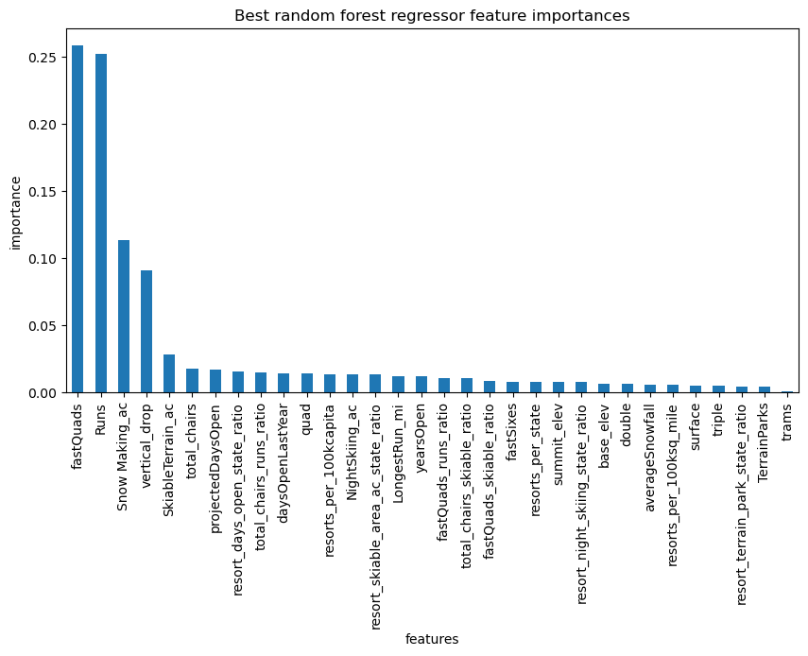
Modeling technicalities
We started with an initial model to predict missing values first and tested both the mean and median to be used to fill in the missing values, the median gave a slightly more accurate data and that’s what we used in our model to fill in the missing data. We used two types of pipelines one using linear regression and another using random forest, the model using random forest gave a more accurate pricing prediction
the best random forest regressor feature by importance was as shown in the graph

